Slide 1
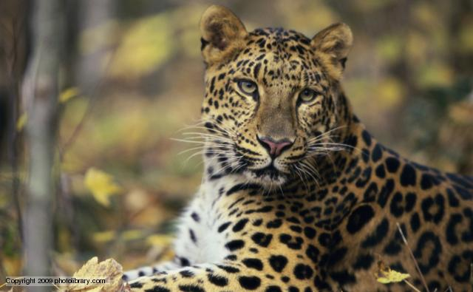
Leopard News
2017-2018 School Year
Oct 23 - 27

Slide 2

Sports- Volleyball
Smith vs. Manor MS Oct 23rd
7th grade home and 8th grade away
Tickets cost $2
B team starts at 5:30pm
A team starts at 6:30pm

Slide 3

Sports- Football
Smith vs. Manor MS Oct 24th
7th grade at Manor MS
8th grade at Shoemaker HS
Tickets cost $2
B team starts at 5:30pm
A team starts at 6:30pm

Slide 4

6th grade Dance:
Friday, Oct 27th starting at 3:30 to 5pm
Tickets can be purchased before school, during lunch and during 9th period in the flex area
Tickets cost $1

Slide 5
6th grade Dance:
NO costumes and please remember to stay within the KISD dress code
Please see Mrs. Taber-Holwerda, Mrs. Lizama, Mrs. Cockrell or Mrs. Franklin for tickets

Slide 6

Band Night:
Come out and support your Leopard Band Friday, Oct 27th starting at 7pm at Leo Buckley Stadium.

Slide 7
Coding Club:
There will be a coding club meeting this Thursday, Oct 26th starting at 3:15pm.

Slide 8
Upcoming Events:
Volleyball game Monday, Oct 30th against Eastern Hills MS
Football game Tuesday, Oct 31st against Eastern Hills MS

Slide 9
Upcoming Events:
Tuesday, Nov 7th come out to McAllisters for a charitea event
From 5pm to 10pm
10% of sales will be donated to Smith Middle School Avid

Slide 10
IDs:
Students your ID must be worn around your neck with the appropriate colored lanyard.
  6th grade- Yellow
  7th grade- Red
  8th grade- Green
If you lose your ID you can purchase a replacement for $5.

Slide 11
Announcements-
Students remember to wear your IDs and make sure that they are out and visible at all times.
Students remember that backpacks are not allowed in the classrooms.

Slide 12
Announcements-
Students check the lost and found located on the ramp to the stage.

